Slide 1

Task No. :05
EMOTION DETECTION
FROM TEXT :

Slide 2
Data Collection -
The dataset is collected from an open source .
The dataset includes a total of 34792 texts which is categorized into eight emotional classes(anger ,disgust, fear, joy , neutral, sadness, shame, surprise) .
Data Preprocessing -
Handle Missing Data:
If there was missing data in the dataset, it was dropped using the dropna() method.
2. Text Cleaning:
User handles, stopwords, and punctuations were removed from the text data using the neattext library.
3.Text to Numerical Representation:
Text was converted into numerical values using the Sentence Transformer model (sentence-transformers/all-MiniLM-L6-v2). The encode() method of the Sentence Transformer model was applied to the 'Clean_Text' column.
4. Handle Class Imbalance:
SMOTE (Synthetic Minority Over-sampling Technique) was applied to oversample the minority emotion classes. This was done to address the class imbalance problem in the dataset.

Slide 3
Data Splitting -
The new balanced dataset was split into training and test datasets where 20% of the data will be used for testing and 80% for training the model.
Model Training -
A comparative analysis was conducted for the task of emotion detection using multiple machine learning models, including Logistic Regression, SVM, and Random Forest.
Logistic regression is a supervised machine learning algorithm that is used for classification tasks, where the goal is to predict the probability that an instance belongs to a given class or not.
Support Vector Machine (SVM) is a powerful model that finds the optimal hyperplane to separate different classes.
Random Forest is an ensemble method that combines multiple decision trees for improved accuracy and robustness.
Once training is completed, the trained model is saved and a function is defined with preprocessing steps to predict the emotion of sample examples.
Afterward, the previously saved model and vectorizer are loaded so that they can be reused later without retraining, especially during deployment.

Slide 4
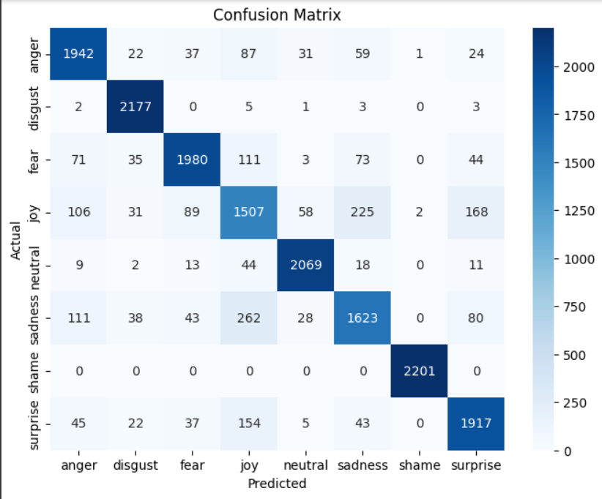
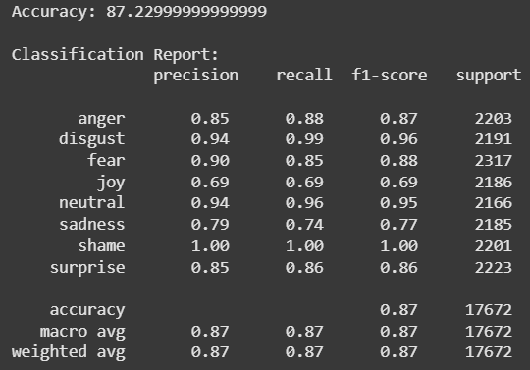
Result Analysis -
Random Forest
The evaluation metrics used here are accuracy, classification report, and confusion matrix.
Random Forest achieved the highest accuracy (87.22%), outperforming Support Vector Machine (70%) and Logistic Regression (68.14%) in this emotion classification task.
The superior performance of Random Forest suggests that emotion classification benefits from a model that can capture complex, non-linear relationships within the text data.
The lower accuracies of Logistic Regression and SVM indicate that linear models are less effective in distinguishing between different emotion categories. This implies that the way emotions are expressed in text is not easily separable by linear boundaries.

Slide 5
Future Scope And Limitations -
Limitations :
Findings :
Future Scope :
The model's ability to work well, especially with unpredictable real-time text, depends a lot on the quality of the data it learned from; this necessitates a dataset that is both high-quality and more or less equally divided across different emotions.
Advanced models, such as deep learning, can be applied to increase accuracy.
Collecting more data, especially for the less accurately predicted emotions.
Trying different feature extraction techniques.

Slide 6
THANK YOU

